Slide 1
Colonoscopy Prep App Outline
James Brief, MD
Max Rogers
John Schroeder

Slide 2


Slide 3
Stony Brook Peds GI Logo animation

Slide 4
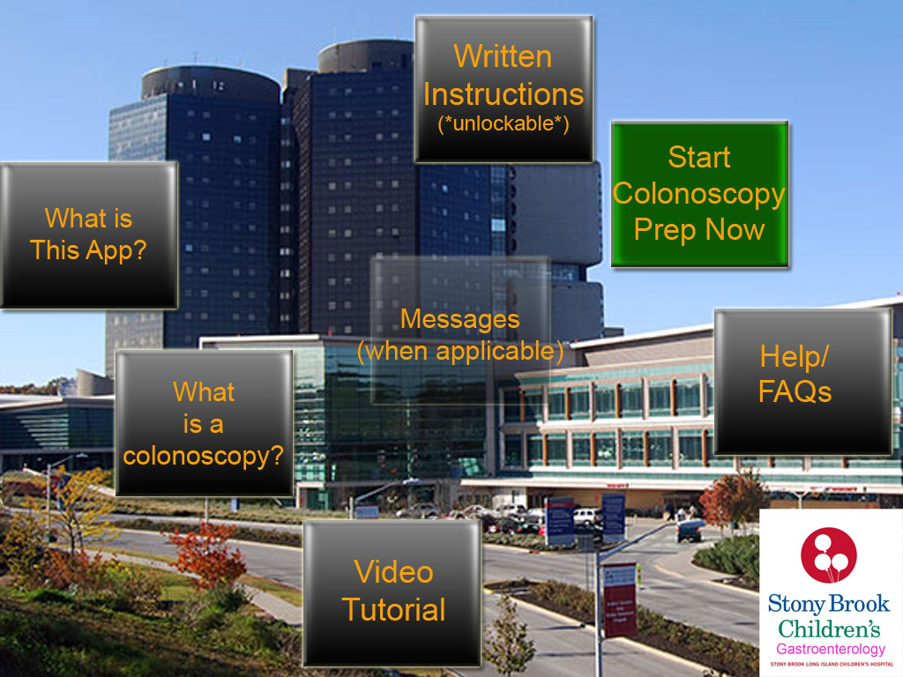

Slide 5
ADMIN button (not pictured) [formerly called “Setup” tab]

Slide 6
Password-locked button
This is where we enter the following information:
Patient’s weight (so that they have prep A, B or C)
Date and Time of their scheduled colonoscopy
Also shows administrators the following information:
When patient viewed video, how many views
- How they answered questions
Which FAQs were accessed
Time/date when patient started/finished 1st and 2nd half of preps

Slide 8
What is this App?

Slide 9
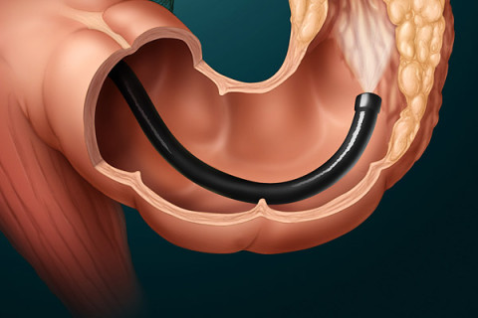
One of the most-difficult parts of a colonoscopy takes place on the day before the procedure when patients must clean out (or “prep”) their bowels so that the doctors can
better visualize the lower intestines. The software that you are now using was designed by the department of pediatric gastroenterology at Stony Brook Children’s Hospital and it is believed to be the first of its kind in the world.
NEXT

Slide 10
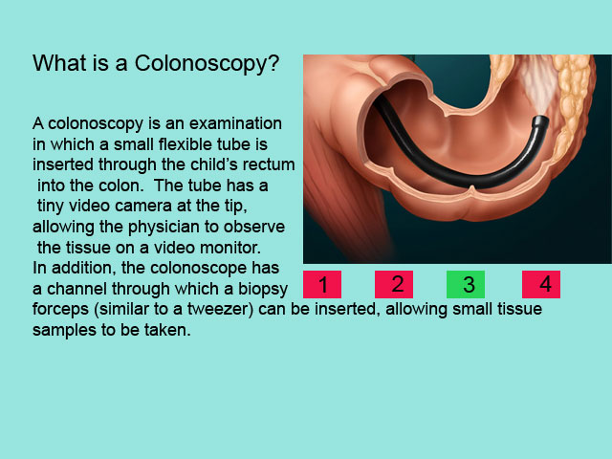
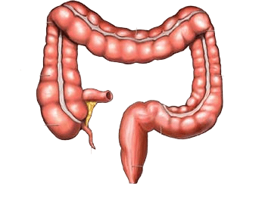

This application will guide you and your child through the entire colonoscopy preparation. Our goal is to make the colon prep experience easier for the patients. This will improve patient satisfaction and result in a more accurate diagnostic procedure for the physicians.
- The Stony Brook Department of Pediatric Gastroenterology
BACK

Slide 12
What is a Colonoscopy?

Slide 13
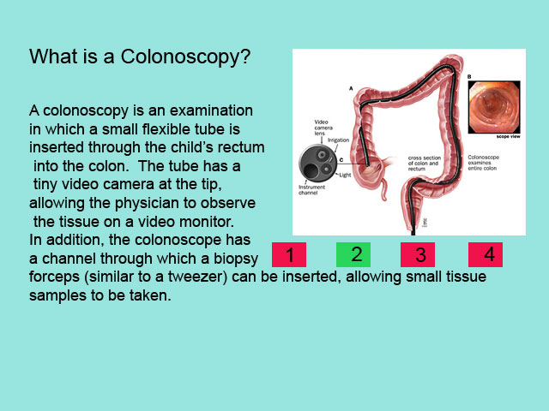
The Colon (large intestine)

Slide 14
Colonoscope passing through the colon (large intestine)

Slide 15
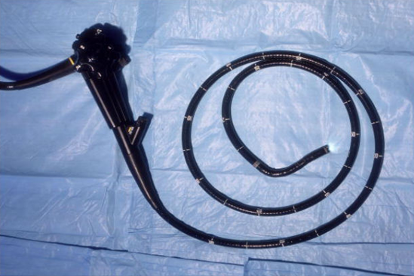

Standard Colonoscope
4

Slide 16
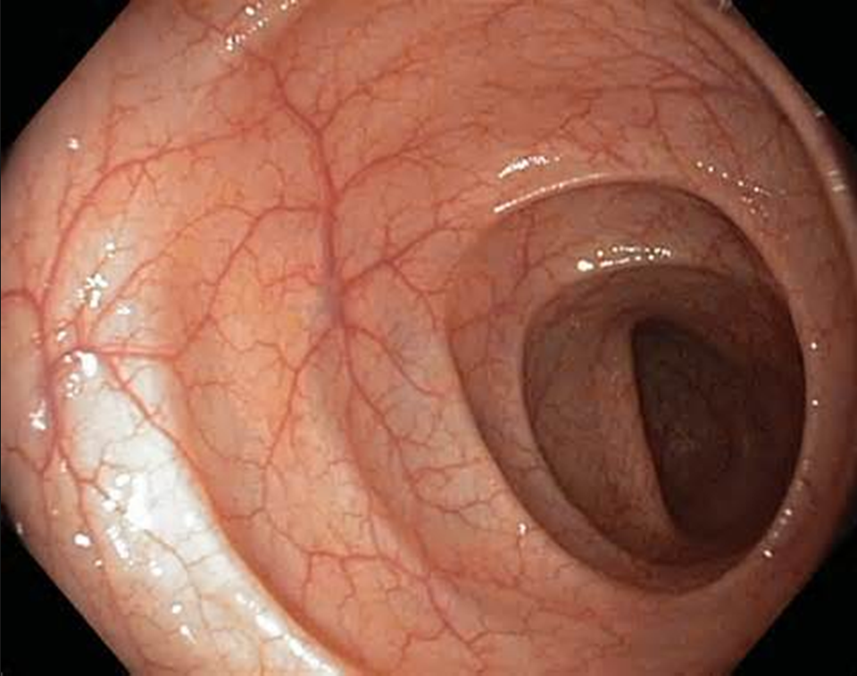
View from inside the colon
1

Slide 18
Video Tutorial

Slide 19
Video seen here

Slide 20
First time going through the video, patients cannot fast-forward. They can only pause or rewind
Once the video has been viewed at least once, this “unlocks” the ability to fast-forward
Once the video has been viewed at least once, this “unlocks” the ability to access the “Written Instructions” icon on the main page
The time/date of the “unlocking” is accessible in the ADMIN panel.
Also, the number of times the video was viewed is accessible in the ADMIN panel

Slide 22
Written Instructions (unlockable)

Slide 23
In addition to the video tutorial, patients can also see a written instructions for the prep
We want to make sure patients view the video at least once, so this option is “locked” until the video is seen in its entirety at least once.
The specific doses are dependent on the patient’s weight class, which we call category A, B or C:
Category A: patient weight <15kg
Category B: patient weight 15-30kg
Category C: patient weight >30kg
The time, date and number of times when patients view written instructions is accessible in the ADMIN panel

Slide 24
The following screens are for a patient with Prep A

Slide 25
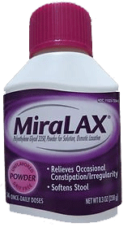
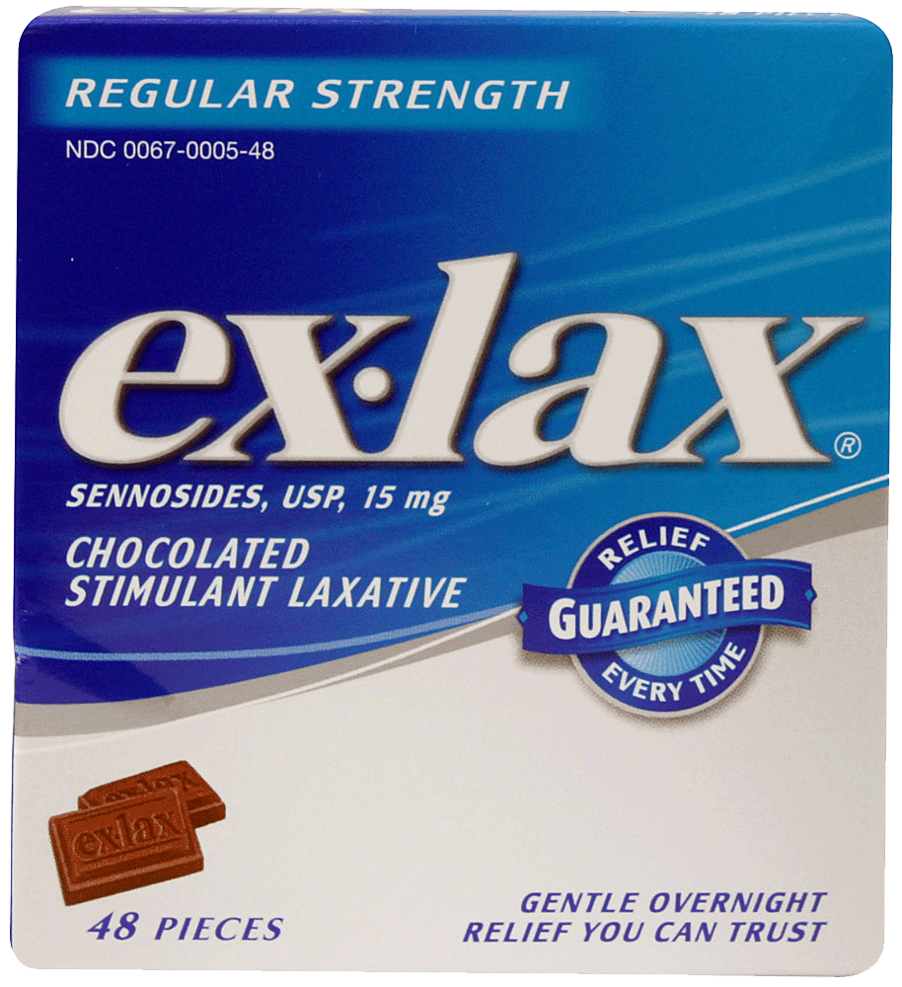
Materials to prepare:
1 chocolate square Ex-Lax (Sennekot)
1 bottle (at least 238 grams) Miralax (Polyethylene Glycol)
This medicine is available over the counter
NEXT

Slide 26
At 8am on the day before you child’s colonoscopy procedure, take the Ex-Lax chocolate Square
Once your child has finished the chocolate, please mix 4 capfuls of Miralax in 18 oz of any liquid and stir well. This can optionally be put it in the refrigerator.
BACK
NEXT

Slide 27
At 12 noon, you should give your child half (9oz) of the Miralax-liquid mixture
Your child must finish the first half of the prep within 3 hours.
After finishing the first half of the prep, please give your child a 2-hour break.
After the break, your child must finish the second half of the prep within another 3 hours.
BACK
NEXT

Slide 28
For the entire day before the colonoscopy, your child must be on a diet consisting of clear liquids only.
- Please avoid using red, orange or purple liquids
Acceptable liquids include water, ginger ale, chicken broth (no chicken or noodles), apple juice, Pedialyte, or Jello.
BACK
NEXT

Slide 29
Where to go on the day of the colonoscopy
The examination is done in the Endoscopy Suite, at Stony Brook University Hospital.
Take the main elevators to the 14th floor. Proceed left to the North Tower to Endoscopy Reception (14N 01).
The actual procedure takes approximately 1 hour, but expect to be at the hospital for about 3-5 hours.
BACK
NEXT

Slide 30
What to expect after the Colonoscopy
Your child will be brought to the recovery room where he or she will continue to rest and allow the effects of the medication to wear off until he or she is fully awake and alert.
Your child may feel a little bloated and pass more gas than usual for several hours after the procedure. This is normal. A sore throat is also common if your child underwent general anesthesia, due to the use of a breathing tube.
BACK
NEXT

Slide 31
What to expect after the Colonoscopy
Not more than about two (2) teaspoons of blood may be seen in your child's bowel movements for no longer than two (2) days following the procedure. If there seems to be more blood or the bleeding lasts longer than two (2) days call the doctor right away.
If biopsies have been taken it will take up to one week to receive the results from the lab. Please call for your biopsy results one week following the procedure.
BACK
HOME

Slide 33
Start Colonoscopy Prep Now

Slide 34

Please press the BEGIN button to start the interactive colonoscopy prep.
BEGIN
BACK

Slide 35
Have your child take 1 Ex-Lax Chocolate square.
Press DONE when your child has finished the chocolate.
DONE
BACK

Slide 36
(app now waits 4 hours, then makes an audio alarm to the user)

Slide 37
4 hours have now gone by since your child took the Ex-Lax square. It is now time to begin taking the Miralax Prep
Please press the MIRALAX picture to start the Miralax prep.
BACK

Slide 38
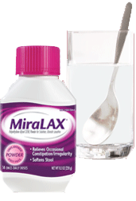
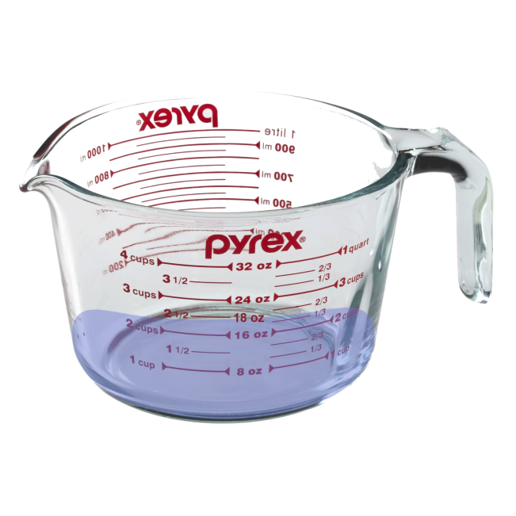
Please mix 4 capfuls of Miralax in 18 ounces of any liquid and stir well
Press DONE when you have finished preparing the Miralax prep
DONE
BACK

Slide 39
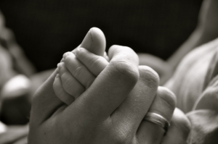
Time left to finish first half of Miralax prep: 03:59:17
Over the next 4 hours, please have your child take half (9oz) of the Miralax Prep
BACK

Slide 40
Time left to finish first half of Miralax prep: 03:01:17
Over the next 4 hours, please have your child take half (9oz) of the Miralax Prep
BACK

Slide 41
Time left to finish first half of Miralax prep: 02:53:22
Over the next 4 hours, please have your child take half (9oz) of the Miralax Prep
BACK

Slide 42
Over the next 4 hours, different tips will randomly appear on the screen, fading into each other
Each tip remains on screen for 2 minutes at a time.
Examples are on the next few screens and will be the only ones we will use for now

Slide 43
Time left to finish first half of Miralax prep: 02:23:44
Over the next 4 hours, please have your child take half (9oz) of the Miralax Prep
For the last 7 hours prior to
the procedure, your child
Should have nothing to eat
or drink.

Slide 44

Time left to finish first half of Miralax prep: 01:01:22
Over the next 4 hours, please have your child take half (9oz) of the Miralax Prep
Once the prep has begun,
your child must be on a diet
consisting of clear liquids only.
Clear liquids are those that
you can see through.
Avoid red, orange or purple
liquids.

Slide 45
Time left to finish first half of Miralax prep: 01:00:44
Over the next 4 hours, please have your child take half (9oz) of the Miralax Prep
It is perfectly fine for your
Child to finish the first half
Of the prep early. You do not
Have to wait the entire 4 hours.

Slide 46
An audio alert warns patients when they have 1 hour, 30 and 10 minutes minutes left to Finish the prep.

Slide 47
Time left to finish first half of Miralax prep: 01:01:22
Over the next 4 hours, please have your child take half (9oz) of the Miralax Prep
Once the prep has begun,
your child must be on a diet
consisting of clear liquids only.
Clear liquids are those that
you can see through.
Avoid red, orange or purple
liquids.

Slide 48

Time left to finish first half of Miralax prep: 00:59:59
Over the next 4 hours, please have your child take half (9oz) of the Miralax Prep
You now have 1 hour left to finish
the first half of the miralax prep
(BEEP BEEP!)

Slide 49

Time left to finish first half of Miralax prep: 00:32:19
Over the next 4 hours, please have your child take half (9oz) of the Miralax Prep
Your child may feel a little
bloated and pass more gas
than usual for several hours
after the procedure. This is
normal.

Slide 50
Time left to finish first half of Miralax prep: 00:29:59
Over the next 4 hours, please have your child take half (9oz) of the Miralax Prep
You now have 30 minutes left to finish
the first half of the miralax prep
(BEEP BEEP!)

Slide 51
Once the 4 hours of the first half of the prep have elapsed, the program will once again sound an audio alarm telling patients that they have finished the first half of the prep.
Users will click the “DONE” button to confirm that they have finished the first half of the prep
The time when the first half is finished is recorded and accessible in the ADMIN panel

Slide 52
By now, your child should be finished with the first half of the prep.
Please press the DONE button to confirm that your child has finished the first half (9oz) of the prep.
DONE
BACK

Slide 53
Questions for patient
After confirming that they have finished the first half of the interactive prep, the following 2 questions will be asked of patients:

Slide 54
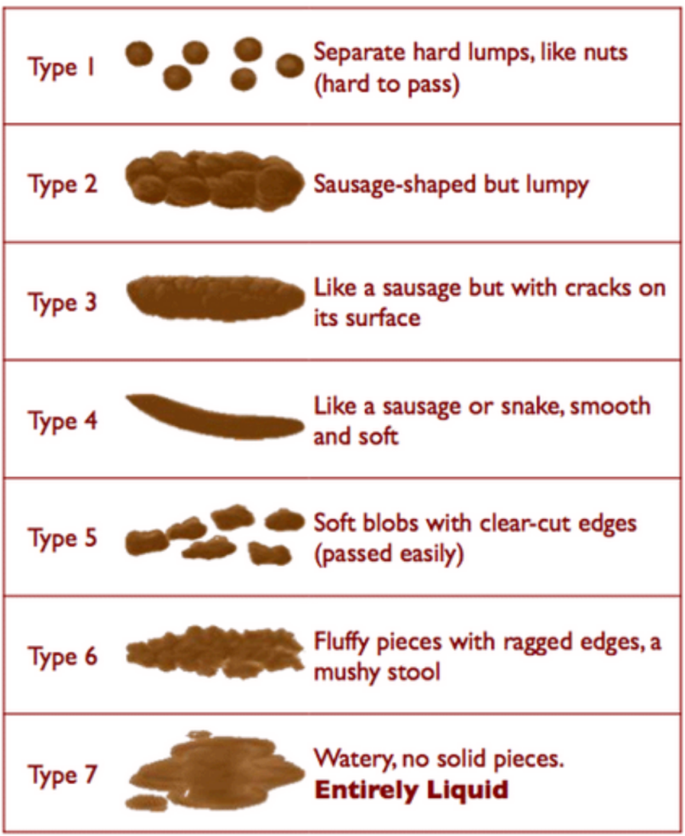
Please tap the panel on the right that best describes your child’s stool output.
If your child is not producing stool, please press the “My child is not producing stool” button
(they highlight a type, then press OK to confirm)
OK
My child is not producing stool

Slide 55
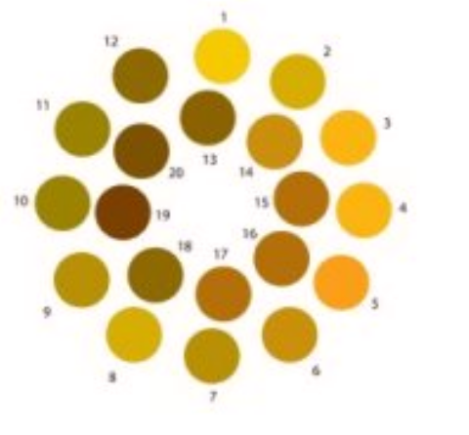
Please tap the panel on the right that best describes your child’s stool color.
If your child is not producing stool, please press the “My child is not producing stool” button
(they highlight a color, then press OK to confirm)
(is this too many colors? Too difficult?)
OK
My child is not producing stool

Slide 56
2nd half of prep
2 hours after finishing the first half of the prep, app will prompt parents to give the 2nd half of the prep

Slide 57
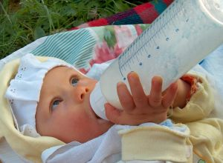
2 hours have passed and it is now time to have your child take the second half (9oz) of Miralax prep.
Once again, you will have another 4 hours to finish the prep
Please press BEGIN
to start the 2nd half of
the Miralax prep.
BEGIN
BACK

Slide 58
2nd half of prep
Patients can tell the app they have finished the 2nd half at any time by hitting the FINISHED button at any time (i.e. it’s not necessary to wait the full 4 hours)
Like the first half, if user doesn’t press the FINISHED button, an audio alert warns patients when they have 1 hour, 30 minutes and 10 minutes left to finish the prep.
After 4 hours, the app makes an audio alert telling the patient that they should be finished with the prep and to press the FINISHED button when actually done
The time when the Second half is finished is recorded and accessible in the ADMIN panel

Slide 59
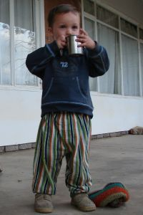
Time left to finish second half of Miralax prep: 03:40:17
Over the next 4 hours, please have your child take the rest (9oz) of the Miralax Prep. Press FINISHED if you finish before the timer ends.
FINISHED

Slide 60


Time left to finish second half of Miralax prep: 01:21:27
Over the next 4 hours, please have your child take the rest (9oz) of the Miralax Prep. Press FINISHED if you finish before the timer ends
The colonoscopy will take
place on the 14th floor of the
main hospital. When you arrive, proceed left to the North Tower to Endoscopy Reception (14N 01). The actual procedure takes approximately 1 hour, but expect to be at the hospital for
about 3-5 hours.
FINISHED

Slide 61
Once FINISHED is pressed…

Slide 62
Time left to finish second half of Miralax prep: 01:21:27
Your child’s Bowel Prep is now complete!!!
Your child’s colonoscopy will
take place at 9am on May 23,
2014 on the 14th floor of the
main hospital. Please arrive 1
hour before your scheduled procedure.
Directions to the hospital can be found here.
Proceed left to the North Tower to Endoscopy Reception (14N 01). The actual procedure takes approximately 1 hour, but expect to be at the hospital for about 3-5 hours.
DONE

Slide 63
(when user clicks on the here link, it links them to Google Maps directions “from current location” to 101 Nicholls Road, Stony Brook, NY 11794)
Date & time of procedure was entered in the ADMIN panel

Slide 64
Questions for patient
After finishing the second half of the interactive prep, the following 2 questions will once again be asked of patients:

Slide 65
Please tap the panel on the right that best describes your child’s stool output.
If your child is not producing stool, please press the “My child is not producing stool” button
(they highlight a type, then press OK to confirm)
OK
My child is not producing stool

Slide 66
Please tap the panel on the right that best describes your child’s stool color.
If your child is not producing stool, please press the “My child is not producing stool” button
(they highlight a color, then press OK to confirm)
(is this too many colors? Too difficult?)
OK
My child is not producing stool

Slide 67
Help/FAQs

Slide 68

FAQs
Click on any question to see the answer
How long after starting the Prep should my child start to go to the bathroom?
My child drank the prep and is going to the bathroom, but it is solid or soft and not “apple juice”-colored. What should I do?
My child drank the prep and has still not gone to the bathroom. What
How long must my child refrain from eating before the colonoscopy?
When will I be able to get results from my child’s colonoscopy?
My child will be in school the day before the colonoscopy. At what time should he/she begin the prep?
BACK

Slide 69

FAQs
Click on any question to see the answer
How long after starting the Prep should my child start to go to the bathroom?
BACK
Each child is different, but most children should have to move their bowels by the time they finish both halves of the Miralax preparation.
If your child has finished the entire bowel prep and still has not had a bowel movement, please wait another 2 hours. If he or she still has not gone to the bathroom, please call (631) 444-6000 and ask to speak to the pediatric gastroenterologist fellow on call.
My child drank the prep and is going to the bathroom, but it is solid or soft and not “apple juice” colored. What should I do?

Slide 70
Which FAQs and number of times accessed should be recorded in ADMIN panel

